Slide 1

Expanding the Context of LLM: Overcoming Limitations
Understanding LLMs in Two Weeks: Insights into Their Mechanism and Impact on Information Retrieval
Notes:
Predicting next token
Token vs Vector

Slide 2

Demystifying Pfizer's Latest Drug Release Using LLMs

Slide 3

Feeding the Beast: How to Train Your LLM?
Retrain
Context

Slide 4

Retrieval-augmented generation (RAG)
Overcoming the Shortcomings of LLMs

Slide 5
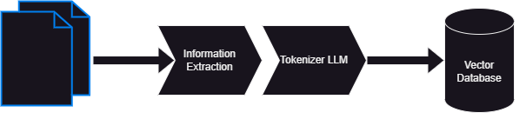
Preparation: Ingesting Documents for LLMs

Slide 6
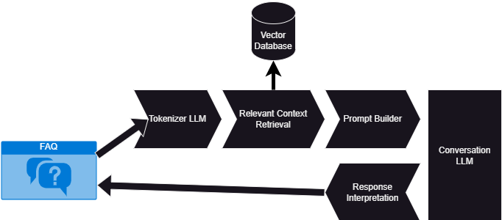
Execution: Asking a question about your document

Slide 7
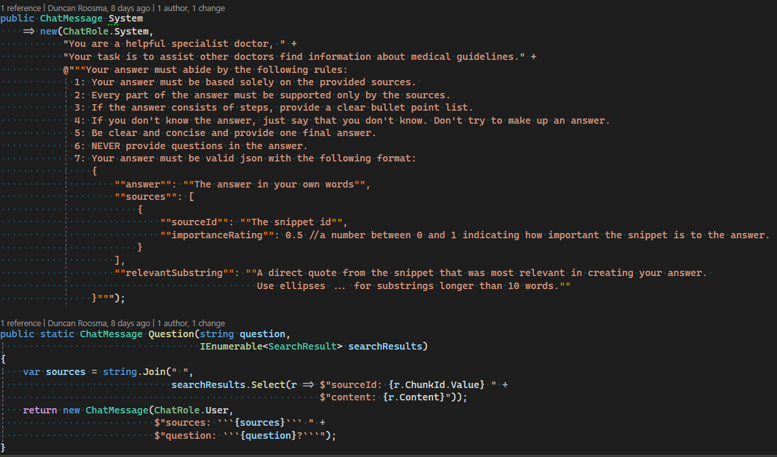

Slide 8

See it to Believe it: Demo of Ingestion and Q&A
Walkthrough of a real-world demonstration...

Slide 9
Tying it All Together: The Grand Finale
Saas Waiting to happen (MS Build)
Python vs C#
Prompt engineering
Privacy
Daydreaming / Hallucinations (bugs)

Slide 10

Open Mic: Q&A Session
Invite the audience to ask their burning questions...

